Slide 1
SARS-CoV-2 omicron variant modelling
Final Report 21/12/21
University of Edinburgh
Bram van Bunnik
Alex Morgan
Mark Woolhouse
Supplementary material added to Report 17/12/21

Slide 2
Summary
The course of the omicron wave in Scotland remains difficult to predict but a very large and hugely disruptive wave of cases appears inevitable and an unmanageably large wave of hospitalisations is possible (Figure 1)
The expected size of the wave is very sensitive both to parameters with still unknown values and to parameters that we can control (booster roll-out rate) or partly control (transmission rate) (Figure 2)
Peak hospitalisations is most sensitive to the transmissibility of omicron in a fully boosted population. For some plausible parameter combinations small differences in overall transmission rates have a big impact on the outcome (Figure 3)
Increased booster roll-out rate has a big impact with more favourable parameter combinations but little impact with less favourable combinations (Figure 4)
Earlier interventions can be less drastic interventions but if interventions are delayed too long then it may not be possible to avert an unmanageably large wave of hospitalisations with any intervention (Figure 5)
Controlling the omicron wave is appreciably easier if generation time is shorter than for delta (Figure 6)
Conclusion: measures taken immediately that significantly reduce transmission rates will have the greatest impact. If measures are delayed then the likelihood of overwhelming the NHS rises substantially and rapidly. The higher the doubling time the greater the urgency.

Slide 3
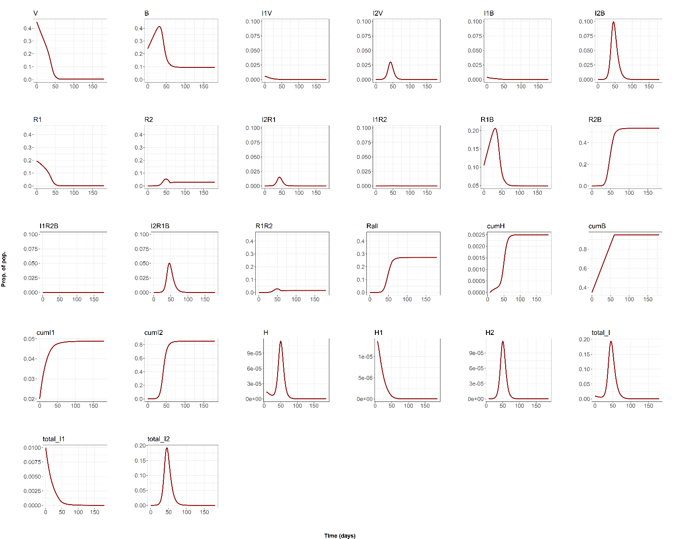
1. Baseline scenario
Peak I
15-20%
Attack rate >80%
Peak H
>7x higher
Dt = 3 days + only difference between variants is 1.6x higher omicron transmissibility (R_delta=0.99)
Boosters give near complete protection against hospitalisation.

Slide 4
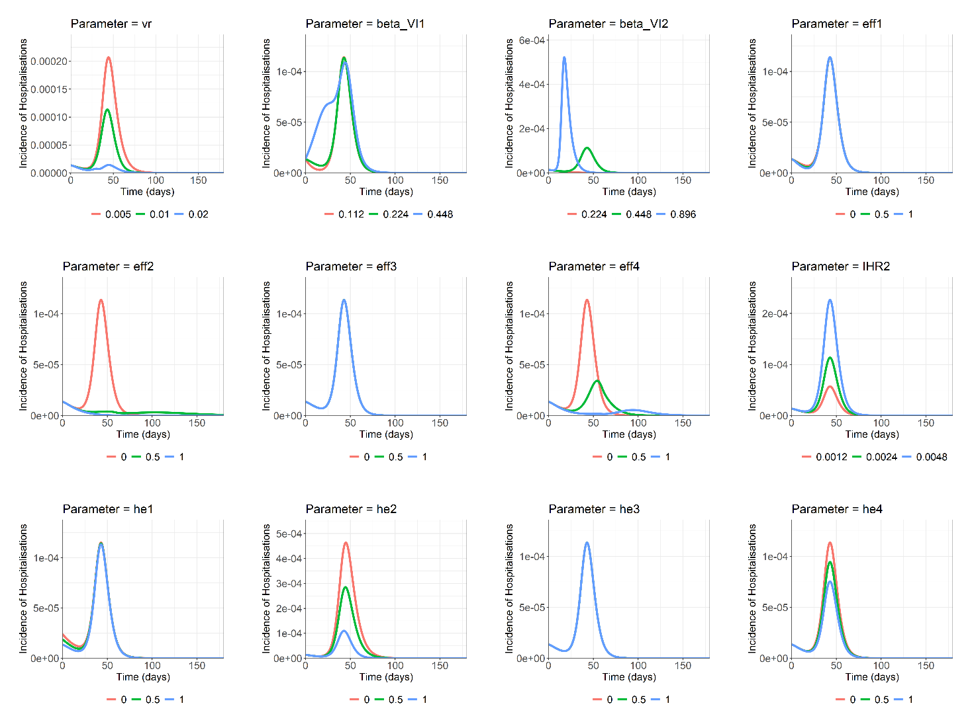
2.Univariate sensitivity analysis
Parameters setting omicron transmission rates
Parameters setting omicron pathogenicity
Parameter setting vaccine roll-out rate

Slide 5
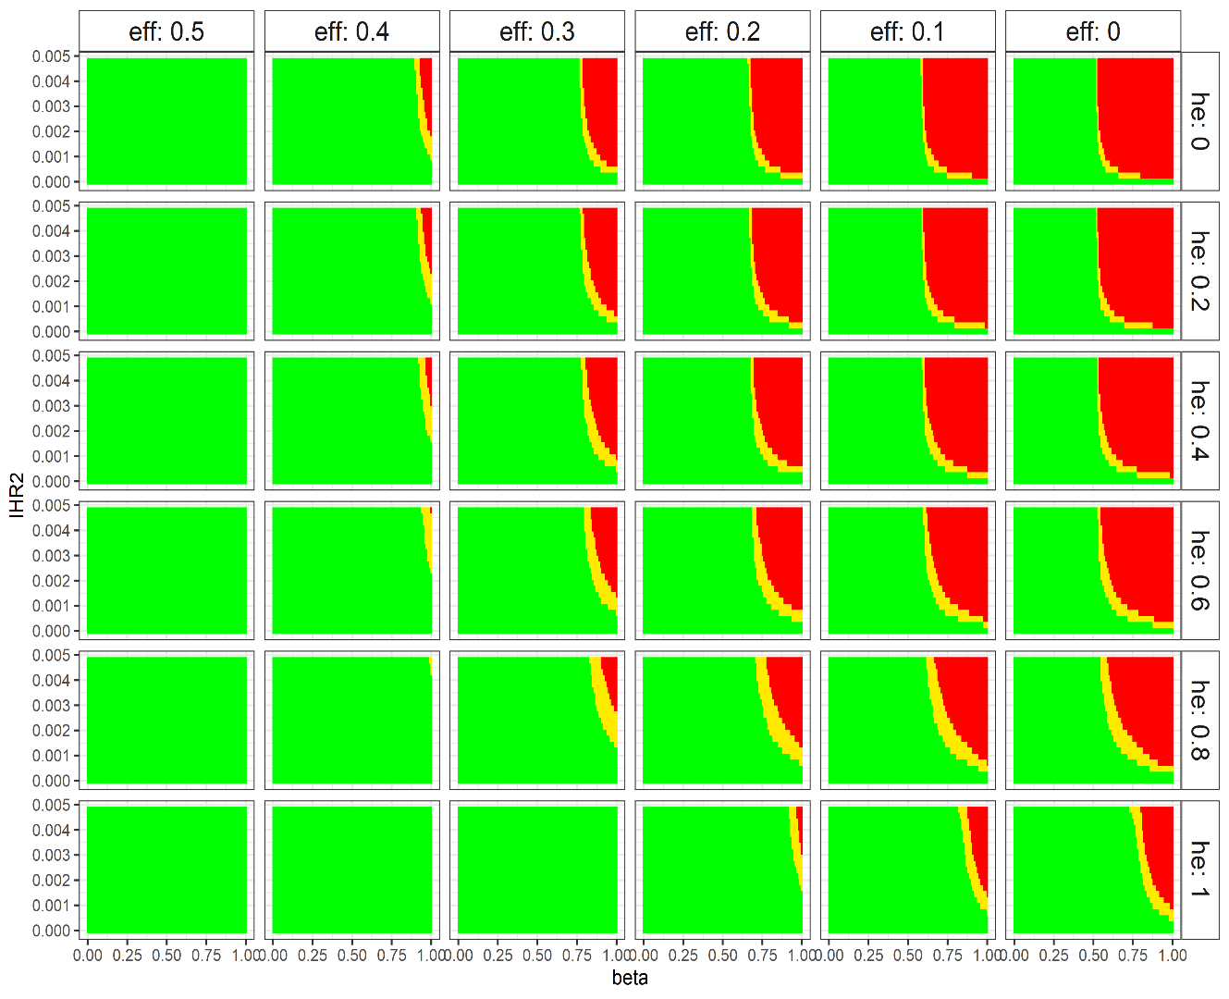
3. Impact of transmission reduction on peak hospitalisations
Increasing effect of booster on transmission
Impact of booster on transmission rates has big effect (50% reduction enough)
Reducing overall transmission rate has big impact (50% reduction enough)
Small changes in transmission rates can have big effects
Lower omicron pathogenicity and higher booster protection against hospitalisation have less impact
= above previous peak
= above 01/12 value
= below current value
Boosters more protective against omicron hospitalisation
Omicron less pathogenic
ILLUSTRATION
ONLY
Decreasing transmission = increasing control effort

Slide 6
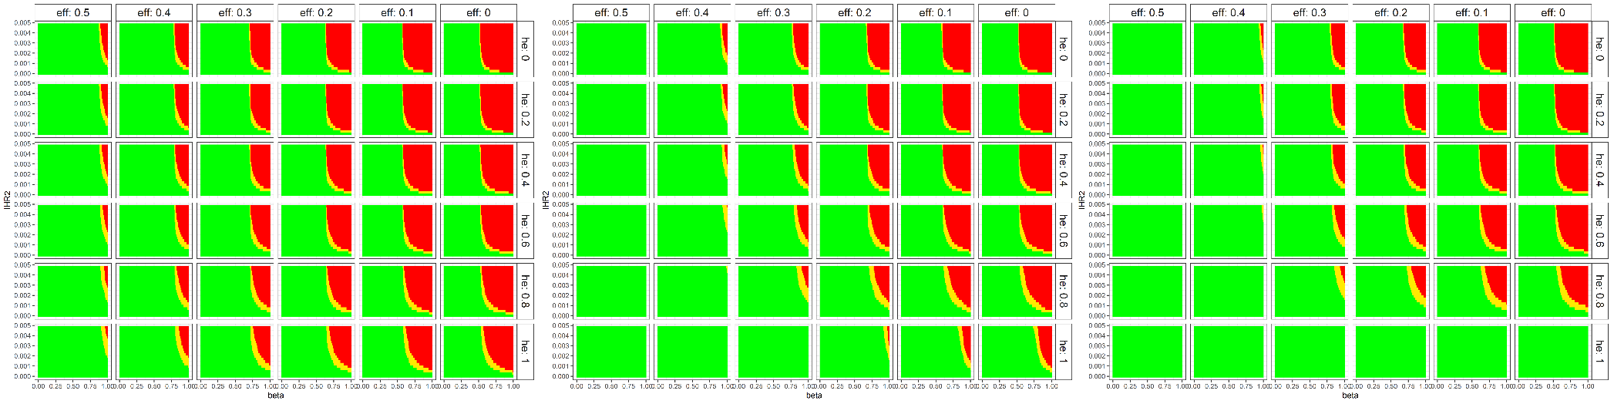
4. Impact of booster roll-out rate on peak hospitalisations
0.5x CURRENT RATE
CURRENT RATE
2x CURRENT RATE
= above previous peak = above 01/12 value = below current value
These simulations compare the previous output (current rate) for lower (0.5x) and higher (2x) vaccine roll-out rates. Changing roll-out rate does not greatly impact the outcome for less favourable parameter combinations (towards top and right) but does at more favourable combinations (towards bottom and left)

Slide 7
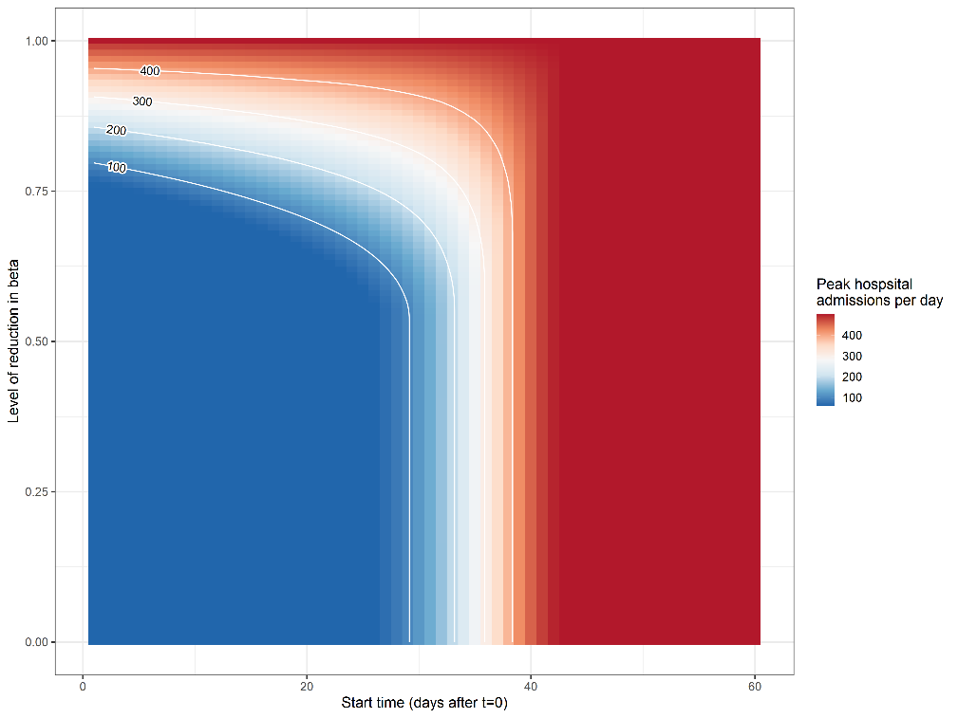
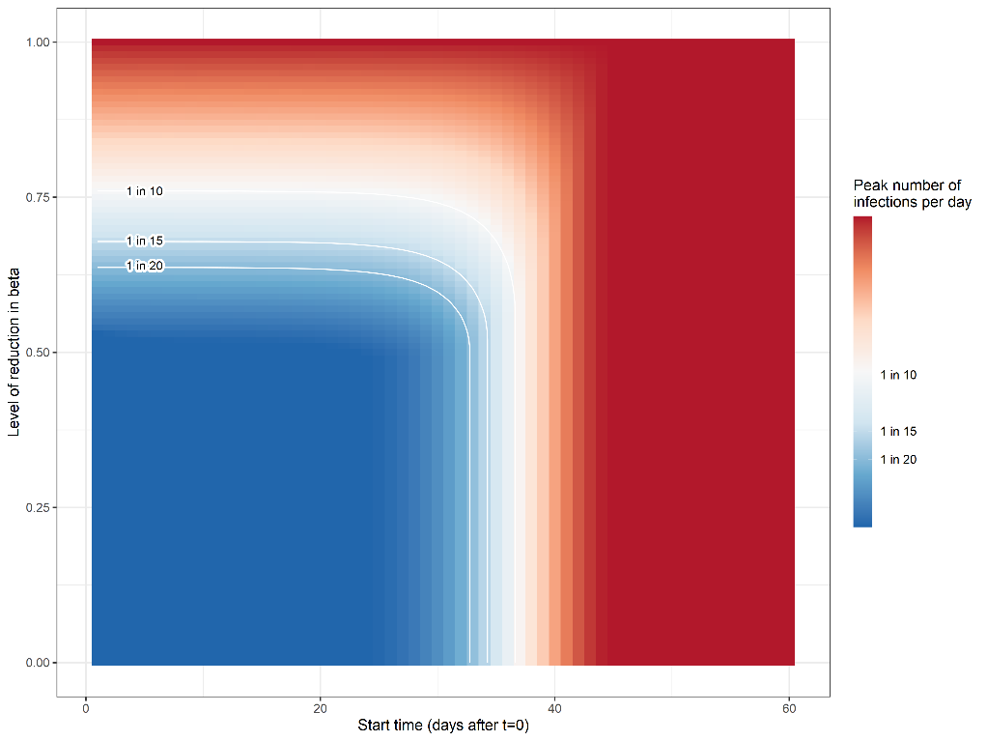
5. Intervention timing and strength
PEAK HOSPITAL ADMISSIONS
PEAK INFECTIONS
1
17
Intensity of control
29
Time (days from 01/12/21)
ILLUSTRATIVE RESULTS FOR THE BASELINE SCENARIO (with Dt=3 days): BEST/WORST CASES GENERATE LOWER/HIGHER VALUES
In this example, if policy objective is to keep peak admissions below 100 per day this requires a 20% reduction in overall transmission at day 1, 29% at day 17, 42% at day 29 and is not achievable thereafter, with this cut-off falling to 23 days for Dt=2 days

Slide 8
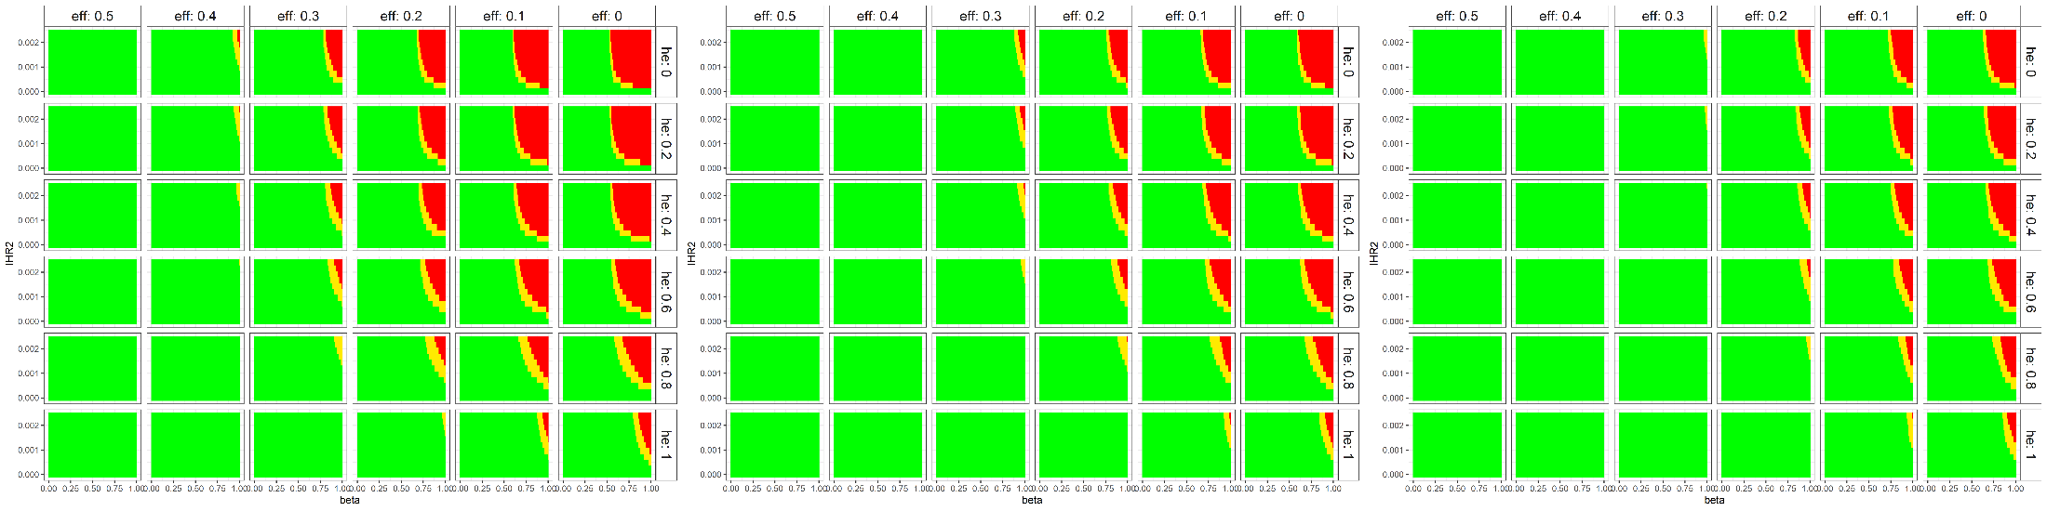
6. Impact of generation time on peak hospitalisations
Gt = 5 days
Gt = 4 days
Gt = 3 days
= above previous peak = above 01/12 value = below current value
These simulations compare the previous output (Gt = 5d) for shorter (Gt = 4d, 3d) generation times. Shorter generation times (linked to lower transmission rates to recover the same doubling time) make it easier to avoid unfavourable outcomes by reducing transmission.

Slide 9
Discussion points
There is still considerable uncertainty regarding the expected scale and impact of an omicron wave in Scotland/UK for three reasons:
Uncertainly about key parameters, especially for the pathogenicity of omicron and the effectiveness of boosters for reducing omicron pathogenicity and transmissibility (we have robust estimates for only 5/18 model parameters)
The dynamics of the ‘race’ between omicron and booster vaccination, such that small differences in parameters have large impact (Figure 3)
Uncertainty about the behavioural response to the wave, both in reaction to and independent of government advice
Scenarios presented are not predictions. It is inconceivable that a major omicron wave would not precipitate significant behaviour change plus a government response – both of which would affect the course of the wave
Broad agreement with range of scenarios generated by other models
Note that there remain plausible combinations of parameters that do not generate a major wave of omicron hospitalisations (especially if significant impact of booster vaccination on transmission of both variants and/or some cross-protection from exposure to delta)
Baseline scenario generates huge wave of infections which would be enormously disruptive in its own right, given current self-isolation requirements – this can happen even if hospitalisations do not rise dramatically
Large regions of parameter space where interventions to suppress transmission (by 50% or less) are highly effective
Outcome is ‘fragile’: very small changes in parameter values associated with big shifts between favourable and unfavourable outcomes → high uncertainty

Slide 10
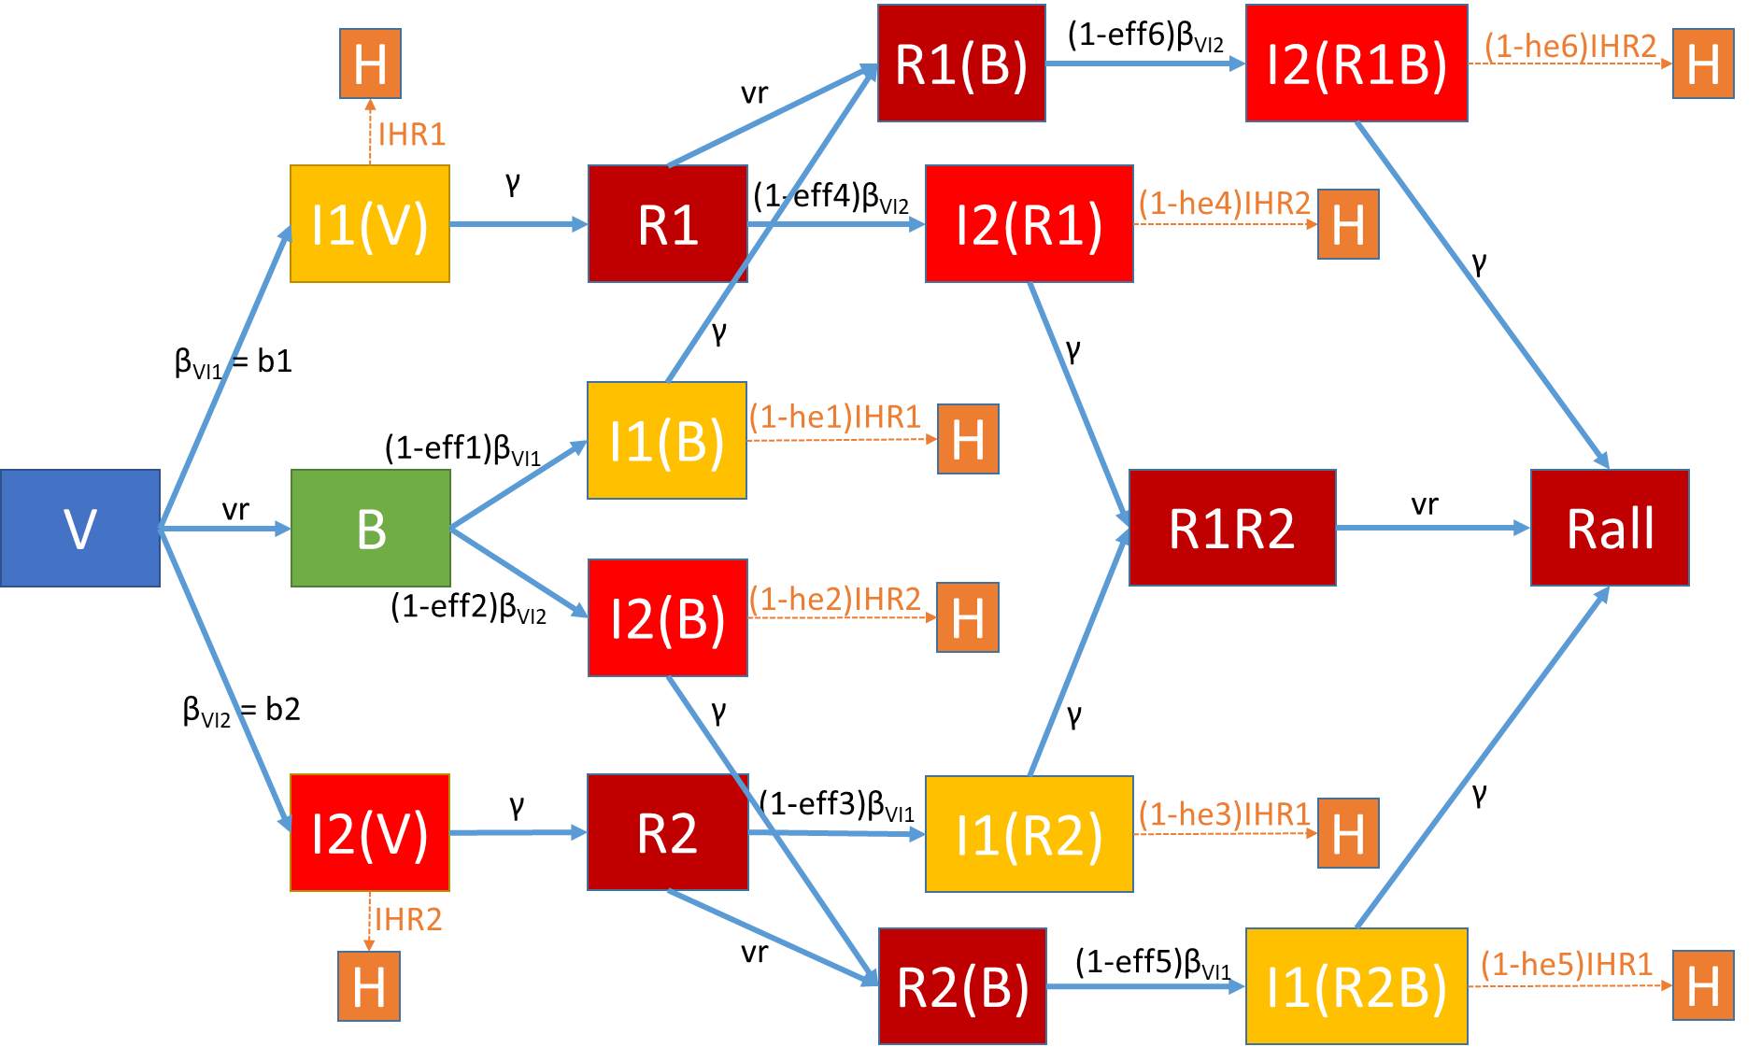
Model structure

Slide 11
Model inputs
Initial values:
Baseline parameter (range sensitivity):
Comp | Initial Value
V | 0.44934
B | 0.240646
I1V | 5.65E-03
I2V | 7.49E-06
I1B | 4.35E-03
I2B | 5.76E-06
R1 | 0.194995
R2 | 0
I2R1 | 4.94E-06
I1R2 | 0
R1B | 0.105
R2B | 0
I1R2B | 0
I2R1B | 0
R1R2 | 0
Rall | 0
Parameter | Value
γ | 0.2
vr | 0.02 (0.01 – 0.04)
β_{VI1} | 0.224 (0.112 – 0.448)
β_{VI2} | 0.448 (0.224 – 0.896)
eff1 | 0 (0 – 1)
eff2 | 0 (0 – 1)
eff3 | 0 (0 – 1)
eff4 | 0 (0 – 1)
eff5 | 0 (0 – 1)
eff6 | 0 (0 – 1)
IHR1 | 0.0024
IHR2 | 0.0024 (0.0012 – 0.0048)
he1 | 0.99 (0 – 1)
he2 | 0.99 (0 – 1)
he3 | 0 (0 – 1)
he4 | 0 (0 – 1)
he5 | 0.99 (0 – 1)
he6 | 0.99 (0 – 1)

Slide 12
Model calibration and implementation
We use a highly simplified compartment model designed to explore some of the key factors likely to determine the course of the current omicron wave. The outputs illustrate general and – we believe – robust patterns but are not intended to be, and should not be interpreted as, precise predictions. R code is available on request.
Two strain “SIR”-model with constant booster-vaccination rate
Immune history taken into account (in a simplified way)
Population of interest is all aged 18+ in Scotland
Population assumed to be mostly vaccinated with 88.5% eligible for booster by t=60 [SG data]. Of these, assume 95% take-up
Booster vaccination modelled as a constant, divided pro rata over eligible compartments.
100 initial cases of omicron variant in Scotland [SGTF data]
Examine approximately one million different parameter combinations
Calibrations:
R_delta at t=0 = 0.99
Admissions at t=0 ≈ 60 cases per day, 40% reduction at t=18 [SPI-M, SG]
Doubling time omicron = 3 days
Initial number of infections ≈ 6000 cases

Slide 13
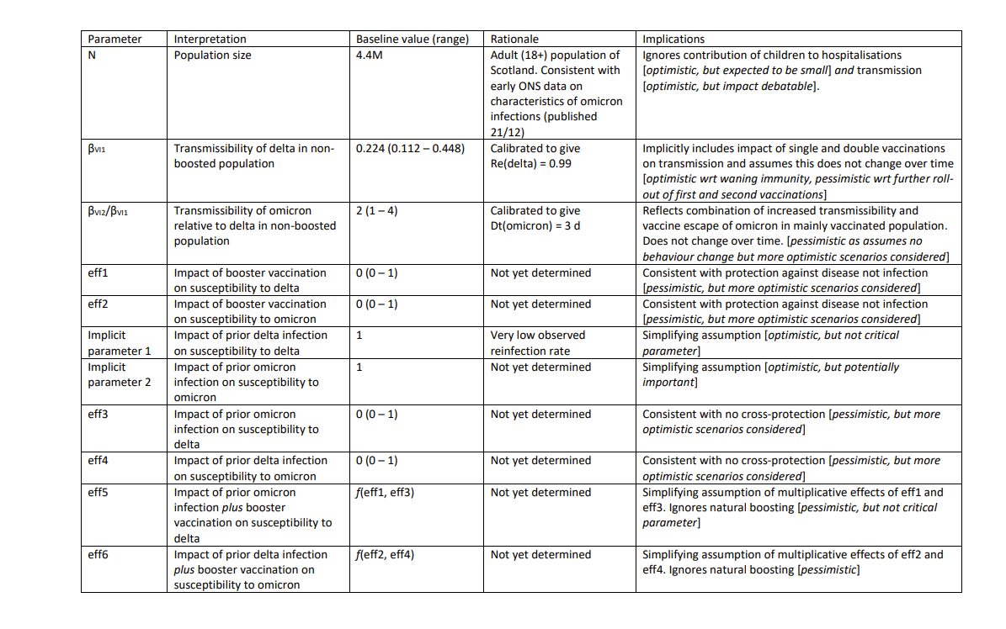
Key assumptions

Slide 14
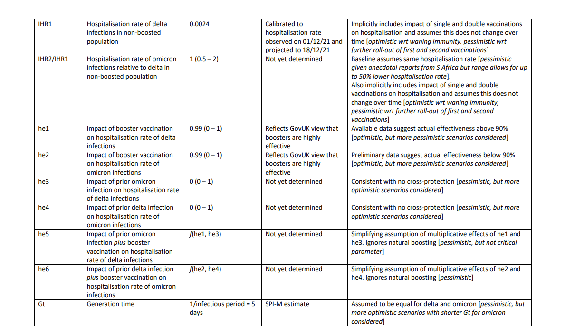
Key assumptions (cont.)

